Slide 1

Solving the Eternity II
Matt Nitzken
Fall 2010
CECS545 – Artificial Intelligence
University of Louisville

Slide 2

What is the Eternity II?
The Eternity II is an edge matching puzzle invented in 2007.
The puzzle functions by connecting pieces divided into sectors together with like sectors to generate a final coherent mapping.
The complexity of the actual puzzle is immense and with 256 pieces making up the original puzzle it is estimated that brute force techniques would require more than 2 x 10⁴⁷ steps to locate a solution.
The puzzle is classified as a type of NP-complete decision problem and thus adding pieces exponentially increases the overall complexity.

Slide 3
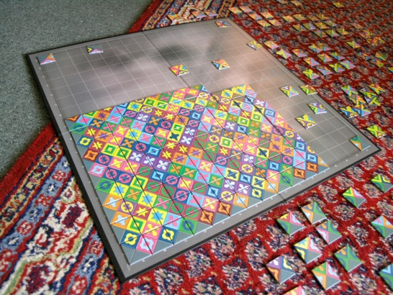
What is the Eternity II?
The puzzle was invented by Christopher Monckton and was released on July 29, 2007.
The puzzle has garnered international attention thanks to the $2 million prize that has been offered for finding the correct and complete solution to the puzzle.
According to the official websites the puzzle has still not been correctly solved and no submitted solution has ever been found to be completely free of errors.

Slide 4
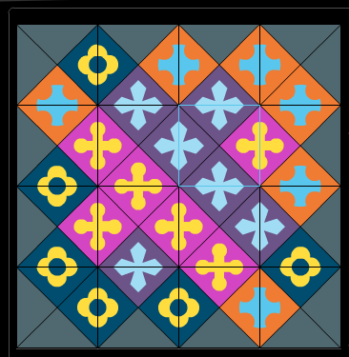
What is the Eternity II?
A piece can have any combination of 22 different colored tiles on it.
The color combination and order is not limited meaning that a piece may have the same color in all 4 positions or a random dispersion of colored pieces.
An edge piece will have a black triangle on a side which connects to the outer edge.
A corner piece therefore has two such black edges indicating it to be a corner.
Pieces are placed such that the outside of the board contains a black border from the edge pieces and with all interior pieces connecting to a matching color piece.

Slide 5
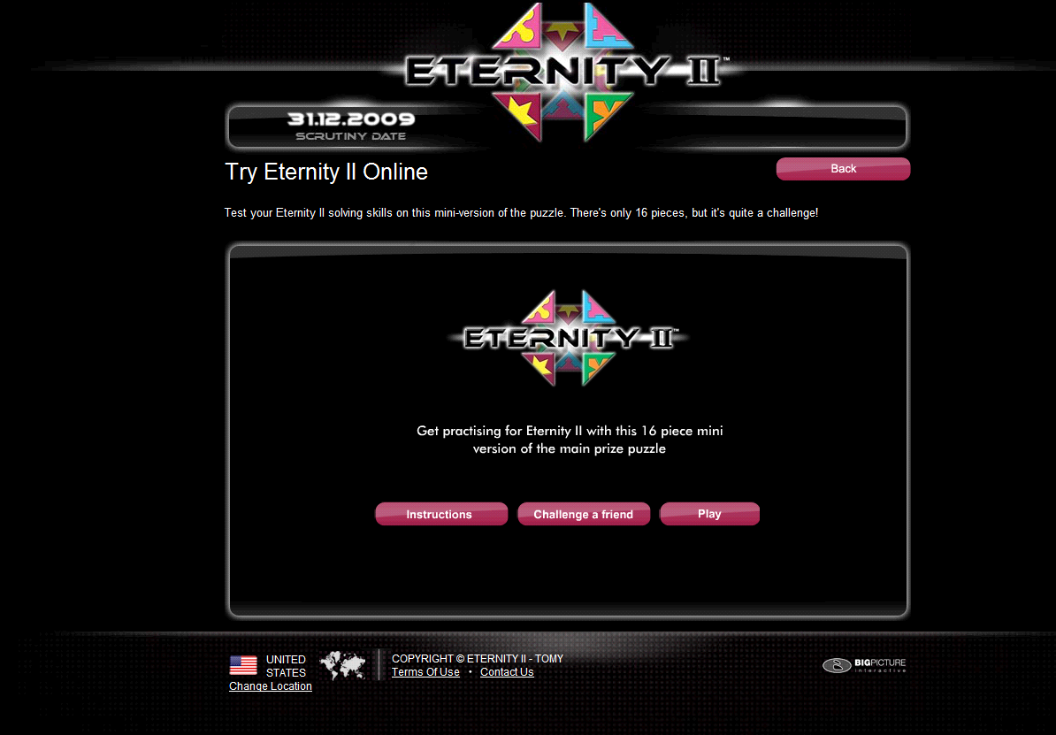
TRY IT!!!
http://us.eternityii.com/try-eternity2-online/

Slide 6
Approach
My solution to a form of Eternity II (EII) puzzle is proposed through the use of genetic algorithms.
Due to the complexity of the EII puzzle and the challenges associated in designing a solver this paper will focus on an asexual variant of a genetic algorithm.
This decision has been made due to the complexity in exchanging individual pieces between separate boards as without a large amount of added complexity the chance for game piece duplication and deletion in the populations becomes very great if not inevitable in future populations making a solution impossible to find.

Slide 7
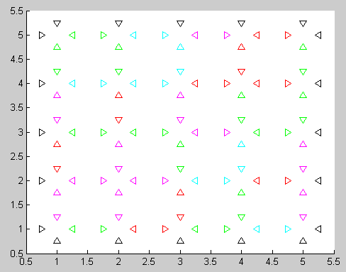
Board Construction
Not having access to an original EII puzzle I designed a simplified method of constructing and testing EII boards.
This was done by generating a blank EII board and filling the edges with a value of 0 representing a black cell.
While the original EII featured over 22 different total colors I simplified my board to include only 4 different colored pieces.
While the framework is easily expandable to use the full number of colors this greatly simplified the computational load on the servers and calculation time required to test a board.
Pieces were generated by randomly selecting a color and then adding the random color to the corresponding piece.
The board was moved through constructing several pieces at a time until the entire board was filled.

Slide 8
Double-Blind Standard
In the construction of test populations a double-blind population generation was used. An initial perfect board was constructed to ensure that the puzzle was actually solvable.
These pieces were then randomized several thousand times using location swaps and rotations of individual pieces to an intermediary board.
This intermediary board was then mutated several hundred times during the construction of each board that would exist in the initial population.
This ensured that the starting population was grossly different from the original board but that the search solution did in fact have an ultimate result and that the puzzle was not unsolvable.

Slide 9
Genetic Algorithm
The GA was constructed in an elitist fashion that was ultimately driven by a Survival of the Fittest (SotF) based approach.
In this form only the top percentage of a population is allowed to reproduce in future populations.
The worst solutions from a population are therefore excluded and have no impact on the children.

Slide 10
Wisdom of Crowds
The Wisdom of Crowds proved to be more of a challenge as it involved combining the knowledge of numerous boards to create a collectively selected board.
The greatest challenge in this stemmed from reconstructing a board that featured only the original set of tiles and ensuring that no tiles were added or removed during the WoC selection process.
To accomplish this a framework was constructed to map the boards against one another.
This created a unique standard matrix that could be used to ensure that the final WoC board was a real board and contained no corrupted tiles.
Each time a piece was placed on the board it was removed from the unique identification pool to ensure that it could not be reused.
The resulting board was the combination of the most popular piece locations and rotations among the entire population.

Slide 11
Genetic Algorithm Parameters
Top Percentage - Used to define the top percentage of the population to use in the offspring.
Mutation Percentage - The percentage the mutation will occur for a board tile.
Attempt Percentage - The maximum percentage of the board that can undergo mutation.

Slide 12
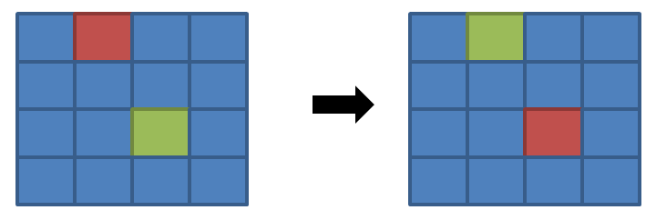
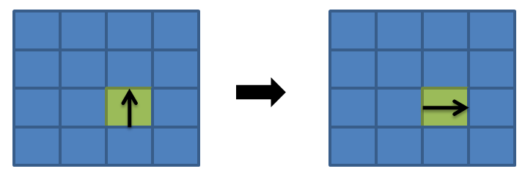
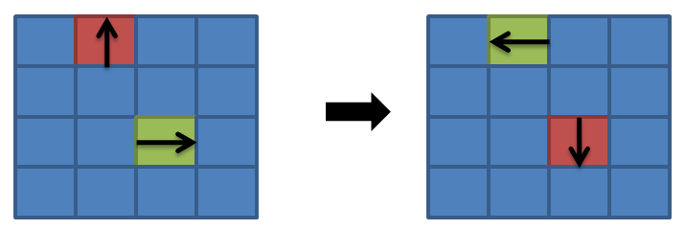
Mutations
The tile exchange mutation operator functioned by selecting 2 tiles and exchanging them within a board.
The twist mutation operator functioned by selecting a tile and twisting it to a new position on the board.
The twist direction change was determined at random being a twist of 1-3 positions.
Lastly a combination of the previous two methods could occur in that two tiles were both repositioned and twisted simultaneously.

Slide 13
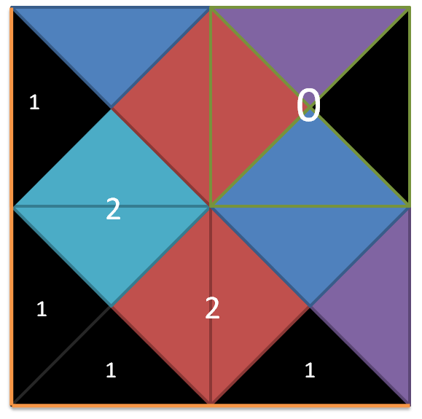
Scoring a Board
If a colored edge was matched correctly than the score of the overall board was increased by 2 for each correct matched piece.
If a piece placed a black edge correctly on an outer edge it received a score increase of 1 and therefore a correctly positioned corner received a score increase of 2.
To further encourage the algorithm to move edge pieces to the edges if a piece had correct color edges and was in the interior of the board but had any black edges it received a score change of 0 regardless of the number of correct edges.
Finally matching two black edges together in the interior resulted in a score change of -1 as this could never happen in a final solution and was greatly discouraged.

Slide 14
Experimental Results
The data was tested in a variety of techniques.
All tests were done using the complex scoring system.
Two different boards were examined, a 5x5 and a 7x7 using both algorithms.
In the 5x5 board several parameters were examined to find the best performance parameters.
These were then examined on the 7x7 board. A population size of 500 was used in test cases.

Slide 15
Random Standard
Both techniques were compared against a standard of pure randomness.
In a pure random test 30,000 boards were randomly constructed from the original tiles.
The highest score from this test was max random score.

Slide 16
Results
 |  |  |  |  | Board Score |  |  | Iterations
Type | Top % | Mutate % | Attempt % |  | Min | Max | Average | Min | Max | Average
Board Size = 5x5
RANDOM |  |  |  | - |  | 38 | - | - | - | -
GA | 30 | 40 | 70 | 55 |  | 57 | 56.3 | 180 | 359 | 261.3
WoC | 30 | 40 | 70 | 34 |  | 41 | 36.3 | 132 | 178 | 154.7
GA | 25 | 50 | 40 | 57 |  | 60 | 58.4 | 118 | 323 | 211.6
WoC | 25 | 50 | 40 | 36 |  | 41 | 38.4 | 119 | 356 | 202.6
GA | 25 | 40 | 40 | 63 |  | 64 | 63.7 | 247 | 378 | 305
WoC | 25 | 40 | 40 | 37 |  | 44 | 41 | 231 | 475 | 326
Board Size = 7x7
RANDOM |  |  |  | - |  | 100 | - | - | - | -
GA | 25 | 40 | 40 | 141 |  | 144 | 142.3 | 199 | 256 | 231.3
WoC | 25 | 40 | 40 | 97 |  | 102 | 99.7 | 135 | 301 | 213.3

Slide 17
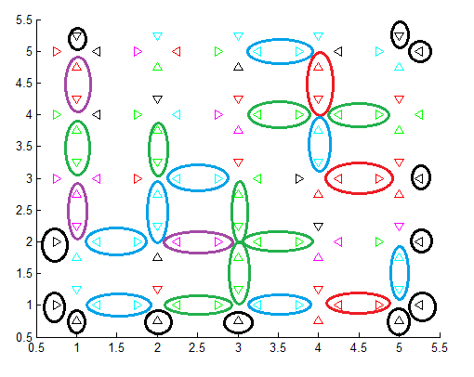
Results
The board showed largely positive results around the edges and while it did not always orient the corners in the correct direction it generally would get the pieces in a corner location.
The edge pieces also generally ended up near or on an edge.
Although I have no reasoning for it I found that regardless of the board created blue and green tiles generally tended to be matched up at a rate of twice or more than the red and magenta tiles.
This occurred in nearly all tests regardless of the random board generated.
I was unable to find a reason for this occurring in any of the code but it was an odd and repeating occurrence in any tests done

Slide 18
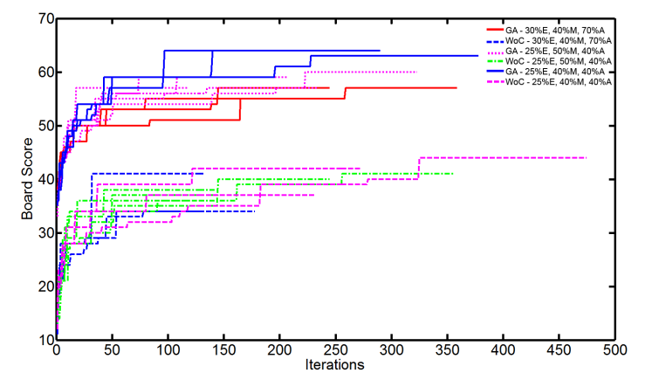
5x5 Board Results
From each test run plots of the Board Score vs. Iteration were generated.
It is easily noticeable that all of the standard SotF genetic algorithms are grouped at the top while the WoC genetic algorithms are clustered at the bottom for the 5x5.

Slide 19
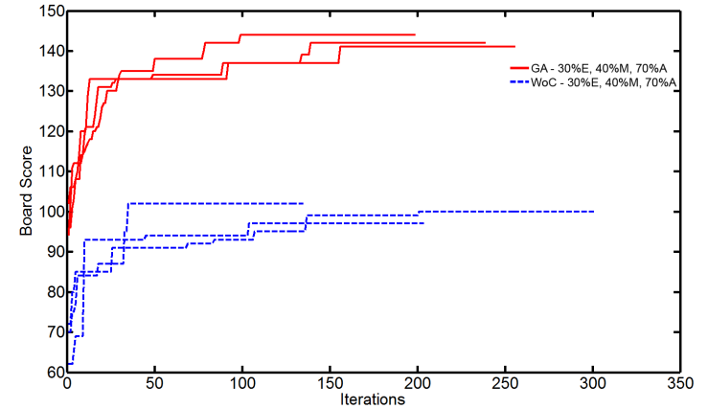
7x7 Board Results
The 7x7 Board showed similar results although with a larger percentage of difference between test groups.

Slide 20
Conclusions
While none of the solutions were able to perfectly solve the EII puzzle the SotF algorithm showed the most promise of the examined techniques.
It may seem odd that given the way Wisdom of Crowds operates it would perform worse than a standard algorithm although I feel it is its innate property that gives it a significant disadvantage in this particular usage scenario.

Slide 21
Wisdom of Crowds Conclusions
A Wisdom of Crowds approach works by pooling together different boards to find a common unique board.
The total number of potential boards must be carefully considered. In this type of NP-Complete problem there are billions or more possible total board combinations.
Using populations of a small size where each individual piece can have hundreds of thousands of different values the likelihood of any piece and exact orientation occurring more than a handful of times even in a moderately large population is slim.
To adequately get a large enough occurrence rate very large populations would be required for the Wisdom of Crowds approach to show significant results.
Unfortunately I did not have access to computers capable of performing such a large calculation load and was therefore unable to test this hypothesis. In my case and the population size it was highly likely that the Wisdom of Crowds was essentially constructing almost completely random boards and that the benefits of the genetic algorithm and population progression were not reflected.

Slide 22
Survival of the Fittest Conclusions
The SotF genetic algorithm approach fared much better.
The WoC explanation would actually explain the positive results from the SotF algorithm.
These boards would directly benefit from the genetic mutation and still be impacted even in a small population.
An individual board was capable of representing the entire populations positive results.

Slide 23
Conclusions
In consideration of the findings I feel that while the algorithms performed opposite of the desired effect that they did perform in an expected way considering the parameters used in the test cases.
In future tests I would like to examine the impact of using a much larger population pool to attempt to solve the puzzle.
Additionally if I could acquire an actual EII puzzle I think it would be interesting to see how the algorithm would perform on the actual board game puzzle.

Slide 24
References
1. TOMY. Eternity II Official Website. 2010; Available from: http://us.eternityii.com/.
2. Ansótegui, C., et al. Edge matching puzzles as hard SAT/CSP benchmarks. 2008: Springer.
3. Demaine, E. and M. Demaine, Jigsaw puzzles, edge matching, and polyomino packing: Connections and complexity. Graphs and Combinatorics, 2007. 23: p. 195-208.
4. Haupt, R., S. Haupt, and J. Wiley, Practical genetic algorithms. 1998: Wiley Online Library.
5. Goldberg, D., Genetic algorithms in search, optimization, and machine learning. 1989: Addison-wesley.
6. Surowiecki, J. and M. Silverman, The wisdom of crowds. American Journal of Physics, 2007. 75: p. 190.
7. Kostakos, V. Is the Crowd's Wisdom Biased? A Quantitative Analysis of Three Online Communities. in Computational Science and Engineering, 2009. CSE '09. International Conference on. 2009.
8. Lee, W.K. The six-piece Chinese jigsaw puzzle: an inspiration to structuring communication. in Professional Communication Conference, 2002. IPCC 2002. Proceedings. IEEE International. 2002.
9. Toyama, F., et al. Assembly of puzzles using a genetic algorithm. in Pattern Recognition, 2002. Proceedings. 16th International Conference on. 2002.
10. Schaus, P. and Y. Deville, Hybridization of CP and VLNS for Eternity II. Journées Francophones de Programmation par Contraintes (JFPC’08), 2008.
11. Makridis, M. and N. Papamarkos, A New Technique for Solving Puzzles. Systems, Man, and Cybernetics, Part B: Cybernetics, IEEE Transactions on, 2010. 40(3): p. 789-797.
12. Muoz, J., G. Gutierrez, and A. Sanchis. Evolutionary techniques in a constraint satisfaction problem: Puzzle Eternity II. in Evolutionary Computation, 2009. CEC '09. IEEE Congress on. 2009.

Slide 25
Thank You

